Slide 1
The Principles of effective lobbying EUCAM
Thursday November 25th 2010
Florence Berteletti Kemp
SFP Director

Slide 2
SFP Key Achievements:
Know what you want?
Elevator Exercise
Process Evaluation
Why is change so hard to achieve
1
What is the Smoke Free Partnership?
2
3
4
5
6
Notes:
“It’s a great privilege for me to address this conference and I wish to thank

Slide 3
What is the Smoke Free Partnership?
The Smoke Free Partnership is composed of 4 Key Partners:
1
The European Respiratory Society (ERS)
2
3
Cancer Research UK (CRUK)
4
The European Heart Network (EHN)
5
6
L’ Institut National du Cancer (INCa)
In 2010 the SFP continues to collaborated with The Union
Notes:
The European Respiratory Society –as you know, with members in over 100 countries, the European Respiratory Society aims to promote lung health through research, knowledge sharing and medical and public education.
Cancer Research UK is the world leading charity dedicated to the fight against cancer. Their annual scientific spend is 213 million which is raised almost entirely by the public
Inca is responsible for providing a global view of the fight against cancer in France
The European Heart Network is a Brussels-based alliance of heart foundations committed to prevention of cardiovascular diseases (CVD),
And the
The Tobacco Control Department of the International Union Against Tuberculosis and Lung Disease (The Union) promote effective tobacco control policies, build capacity for tobacco control through management and technical training, and support implementation of effective programmes through technical assistance in low and middle income countries.
The Smoke free Partnership was created to support its Partners’s work on tobacco control and ensure the effective implementation of the Framework Convention on Tobacco Control (FCTC).

Slide 4
What is the Smoke Free Partnership?
The SFP mission is the effective implementation of the Framework Convention on Tobacco Control (FCTC)
1
The SFP works with policy makers to ensure that tobacco control receives adequate political attention at EU level
2
3
4
The SFP promote tobacco control information and policy research in all policies, principally at EU level but also at national level
5
6
Our advocacy work reflects our values: It is based on partnerships, it is evidence based, efficient, effective and innovative
Notes:
2,600 stakeholders have an office in Brussels and 15,000 lobbyists namely consultants, lawyers, trade organisations, corporations and NGOS seek to influence Commission officials and Members of the European Parliament (MEP) everyday.
The tobacco industry sends many lobbyist to Brussels and to European Institutions; The SFP was also created to counter balance their strategies….
To this end, we work with decision makers to ensure that tobacco control receives adequate political attention at EU level, we provide tobacco-control information and policy research and we work in collaboration with other EU health organisations and tobacco-control networks such as the European Network for Smoking Prevention and the European Cancer leagues, amongst others.
Our main areas of work are: Smoke Free Policies, Taxation and smuggling of tobacco products, Tobacco product regulation and global networking regarding the development and the implementation of the FCTC.

Slide 5
What is the Smoke Free Partnership?
Since 2006, SFP has been at the forefront of key and successful campaigns in a number of important EU TC policy areas (Tobacco Free Europe campaign, Smokefree Policies, Tobacco Tax Directive, FCTC 5.3 guidelines, RIP cigarettes, etc…)
1
2
3
4
5
SFP is the only established organization working exclusively on key EU policy analysis.
6
Notes:
ERS created SFP and is an intergral part of it
Since its creation in 2006, SFP has been at the forefront of key and successful campaigns in a number of important EU TC policy areas (Smoke free Policies, Tobacco Tax Directive, 5.3 guidelines, etc…)
SFP is currently the only established organization working exclusively on key EU policy analysis. I
t draws its strengths from its strong partnership with the European institutions, EU level organizations, MS organizations and universities.
Because of its established and effective relationship with other key tobacco control organisation, the SFP is also be able to involve other partners (WHO, ENSP, ECL, ASH) in its campaign.

Slide 6
What is the Smoke Free Partnership?
SFP draws its strengths from its strong partnership with the European institutions (EC, EP, Council), EU level organizations, MS organizations and universities.
1
2
3
4
Because of its established and effective relationship with other key tobacco control organisation, the SFP is also able to involve other partners (WHO, FCA, EPHA, ECL, ENSP, ASH) in its campaigns.
5
6
Notes:
ERS created SFP and is an intergral part of it
Since its creation in 2006, SFP has been at the forefront of key and successful campaigns in a number of important EU TC policy areas (Smoke free Policies, Tobacco Tax Directive, 5.3 guidelines, etc…)
SFP is currently the only established organization working exclusively on key EU policy analysis. I
t draws its strengths from its strong partnership with the European institutions, EU level organizations, MS organizations and universities.
Because of its established and effective relationship with other key tobacco control organisation, the SFP is also be able to involve other partners (WHO, ENSP, ECL, ASH) in its campaign.

Slide 7
Key SFP achievements :
Programme components & action plan
About Burson-Marsteller Brussels
Our Team
Budget
1
Project objectives
2
3
4
5
6

Slide 8
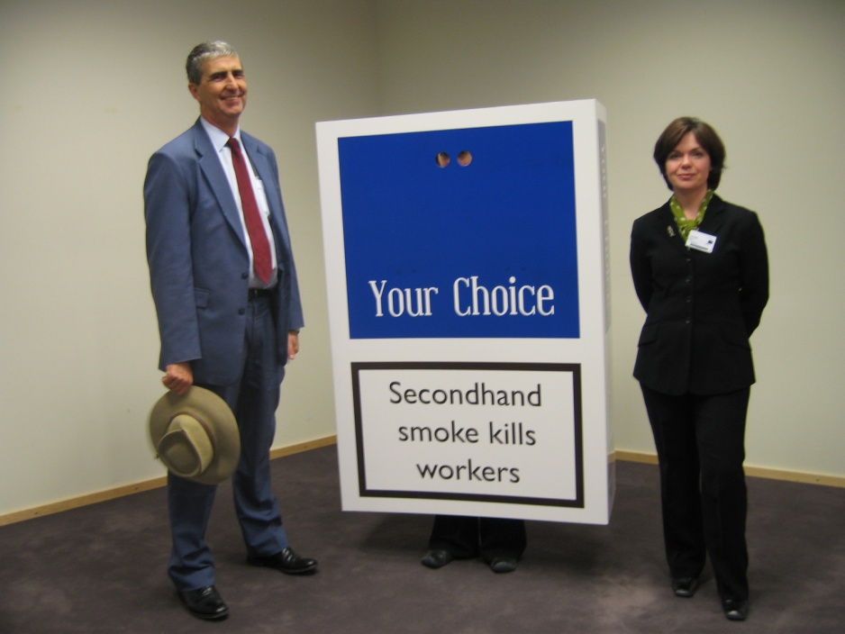
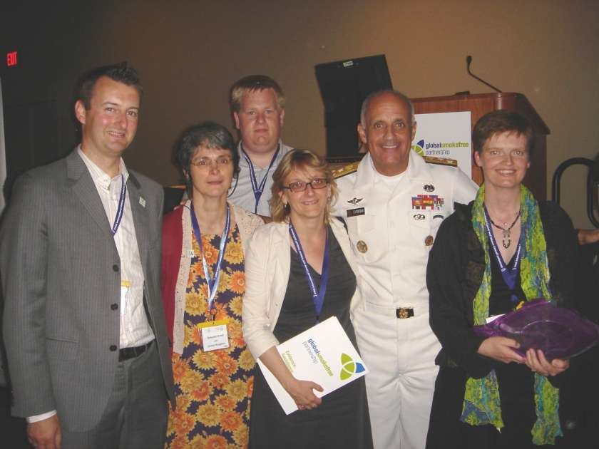
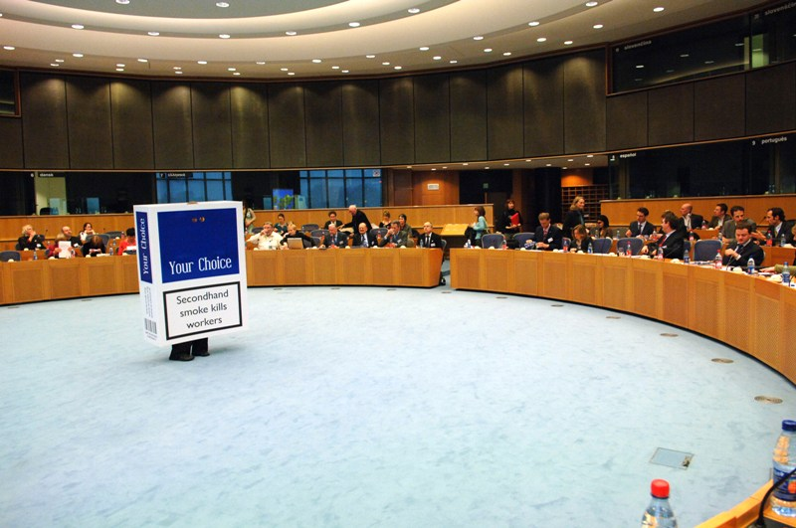
2006: Launch of lifting the Smokescreen
1
2
Best Smoke Free Research Policy Award 2006
In the presence of the Surgeon General
3
Passive smoking kills 79,000 EU citizens
4
5
6
Notes:
On March 21, 2006,
On March 21, 2006, the SFP, & the EHN launched Lifting the smokescreen: 10 reasons for going smokefree at the European Parliament.
It was the first EU repot on passive smoking: Passive smoking kills 79,000 EU citizens a year.
Lifting the Smokescreen was presented with the Best Smoke Free Research Policy Award 2006 at the Global Smokefree Partnership inaugural awards, in the presence of the Surgeon General during the 13th World Conference on Tobacco or Health, Washington DC.
Since then, it is quoted as the main reference in all official documents regarding smoke free policies, including the European Commission documents.

Slide 9
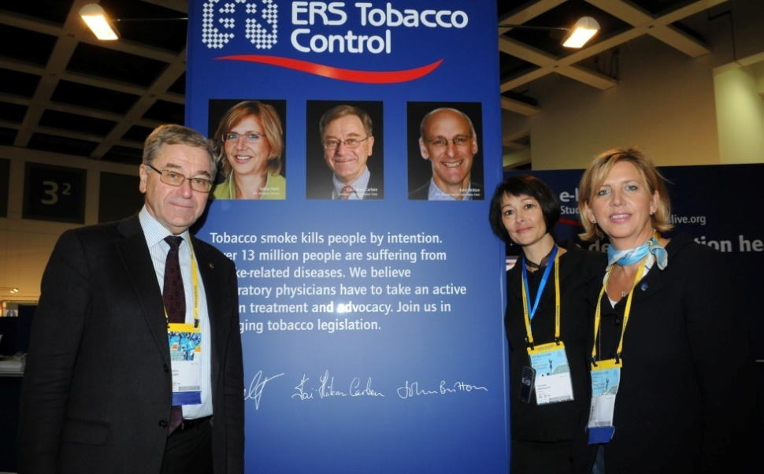
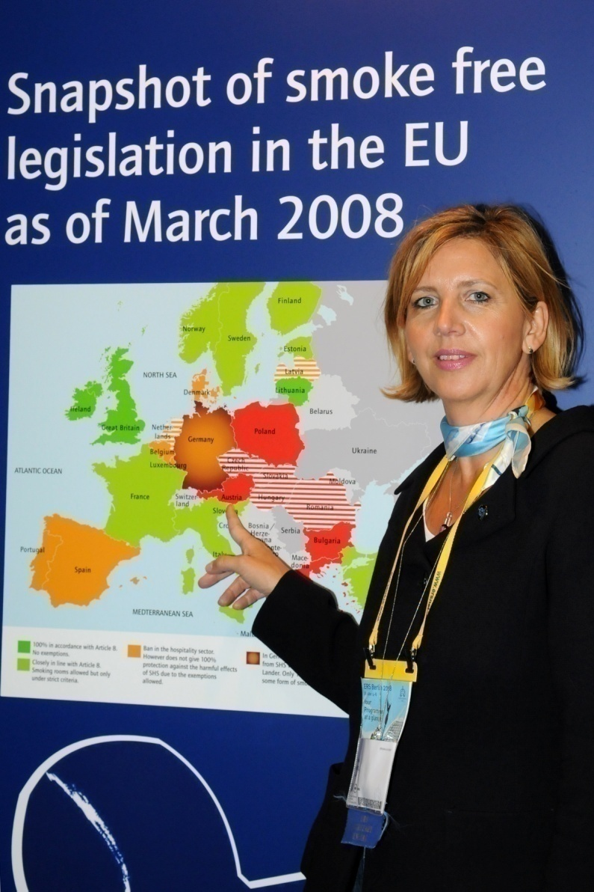
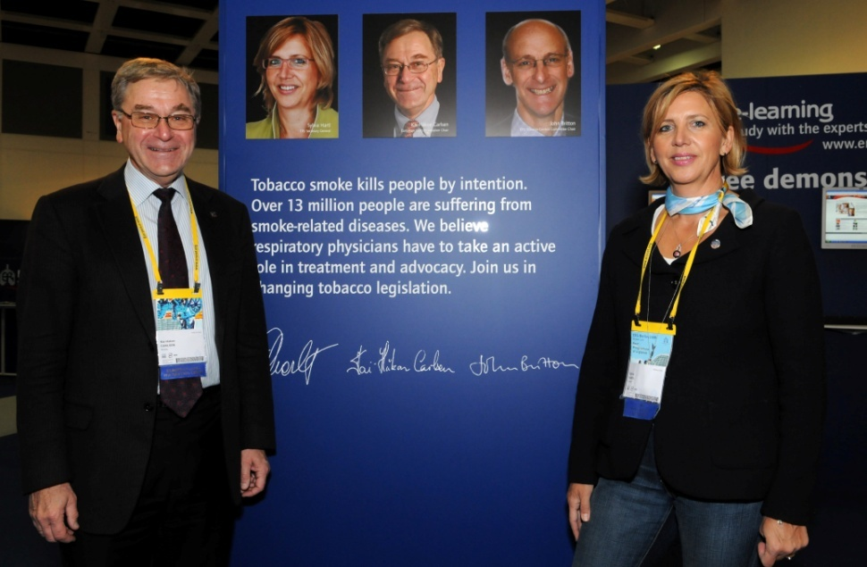
SFP and ERS working together: ERS congress in Berlin
1
2
3
4
5
6
Notes:
SFP and ERS worked closely together at the last congress in Berlin last year to raise awareness about smoke free policies in Europe. We will talk more about this later on today…

Slide 10
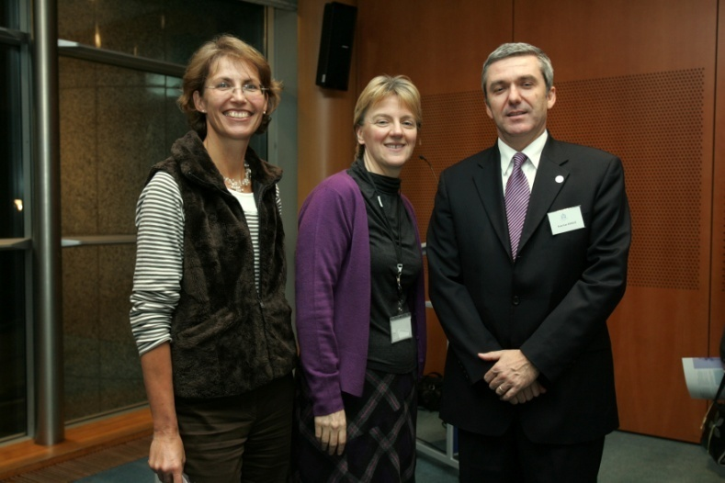
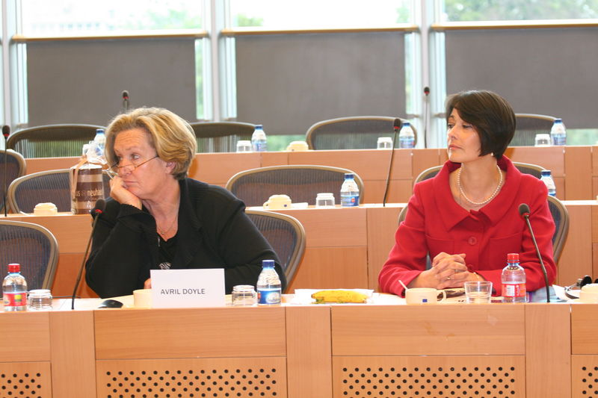
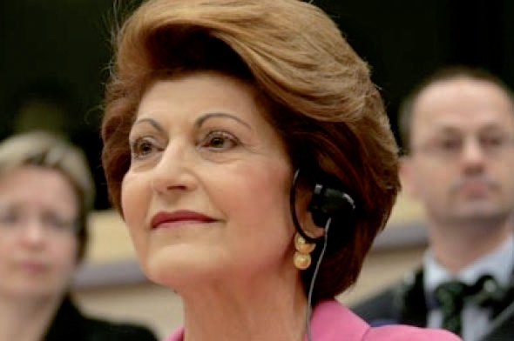
2008… Spotlight on the FCTC series…
1
2
3
4
5
6
Notes:
The first briefing paper "Spotlight on the FCTC” was launched on January 30 2008 at a cocktail reception in the European Parliament, Brussels. The event was hosted by Linda McAvan MEP and was also be attended by many key MEPS, Commission officials and national attaches.
In 2008 and 2009, we organised seminars and hearings all linked to topics linked to an FCTC article….
For instance, the third issue of the Spotlight on the FCTC focused on the role of article 5.3 of the WHO Framework Convention on Tobacco Control in protecting public policy from tobacco industry influence. On July 15, we organised a seminar in the European Parliament (Brussels) on this topic.
Speakers included Mrs. Androulla Vassilou (EU Commissioner for Health), Dr Anna Gilmore (University of Bath), Mr. Akinbode Oluwafemi (Environmental Rights Action’s Manager in Lagos, Nigeria) and Mrs. Jean King (Smokefree Partnership).
The seminar was hosted by Mrs. Avril Doyle, MEP.
Strong 5.3 guidelines were adopted at the conference of the Parties in South Africa in 2009

Slide 11
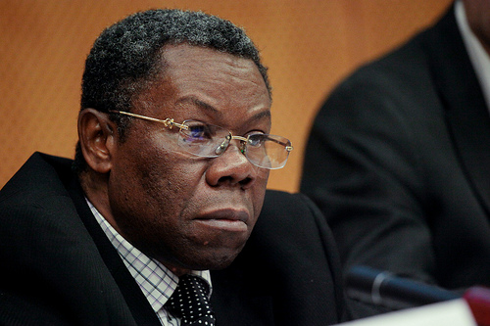
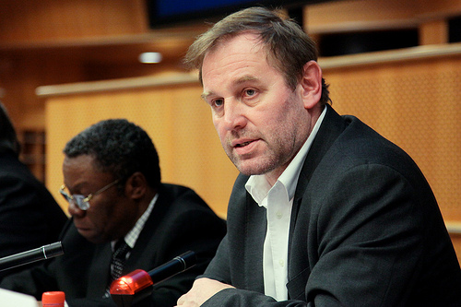
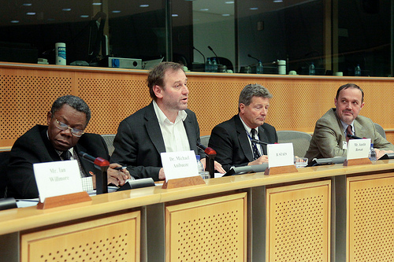
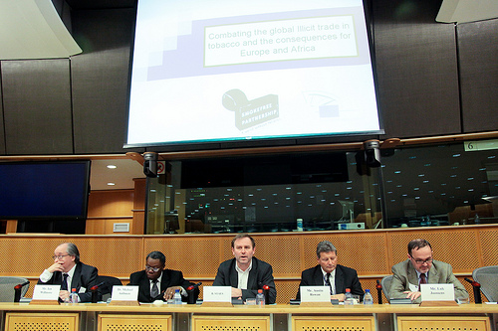
1 February 2010
1
2
3
4
5
6

Slide 12
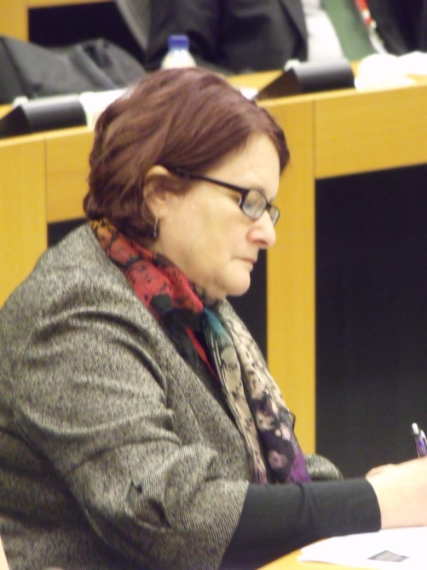
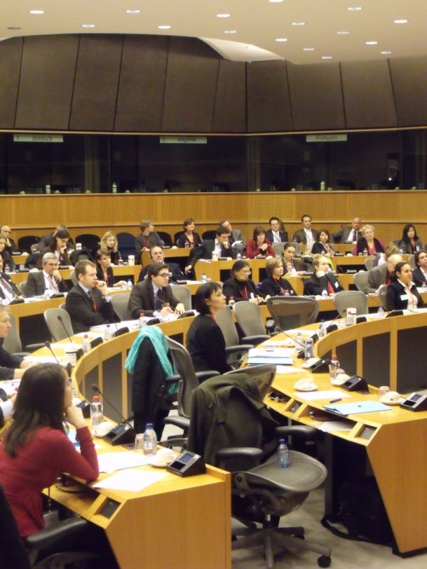
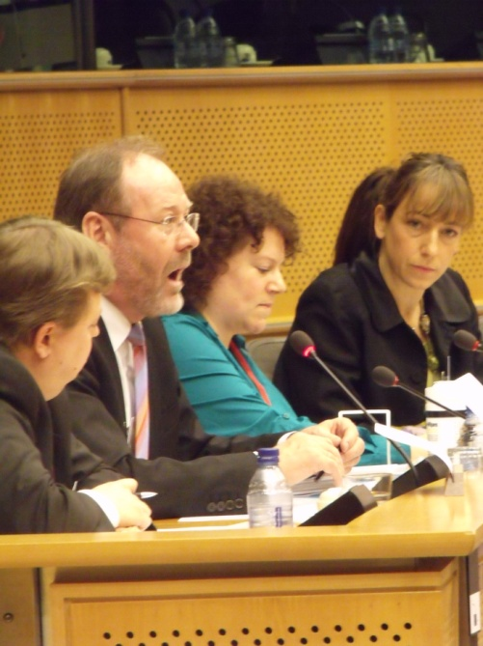
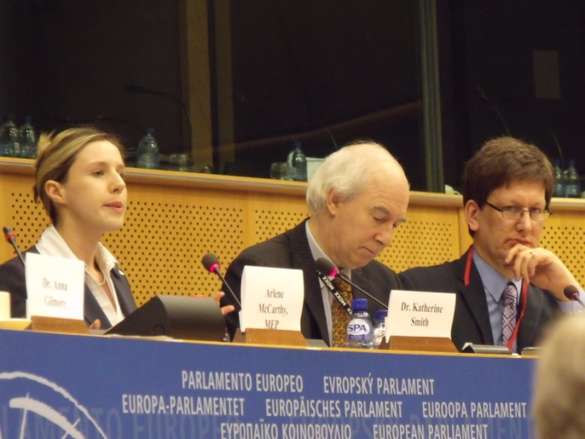
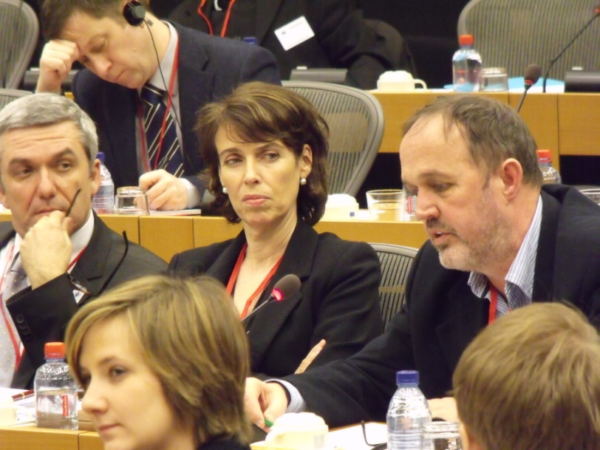
24 February 2010
1
2
3
4
5
6

Slide 13
31st May 2010 WNTD
1
2
3
4
5
6

Slide 14
31st May 2010 WNTD
1
2
3
4
5
6

Slide 15
31st May 2010 WNTD
1
2
3
4
5
6

Slide 16
31st May 2010 WNTD
1
2
3
4
5
6

Slide 17
31st May 2010 WNTD
1
2
3
4
5
6

Slide 18
31st May 2010 WNTD
1
2
3
4
5
6

Slide 19
31st May 2010 WNTD
1
2
3
4
5
6

Slide 20
31st May 2010 WNTD
1
2
3
4
5
6

Slide 21
Our Strategy & approach
Know what you want:
About Burson-Marsteller Brussels
Our Team
Budget
1
Project objectives
2
3
4
5
6
Notes:
WHAT IS A CAMPAIGN STRATEGY?
it should be guided by thoughtful planning. Learn as much as possible about: the existing situation who is affected by the campaign issue both positively and negatively, what changes could improve the situation , what resources, tactics and tools are available to implement a campaign that will address the issue, use this knowledge to create your strategy, planning, implementing, marketing, monitoring, improving and evaluating your campaign.
A campaign strategy should answer the following questions:
Problem, Vision, Change What problem are you confronting? What is your vision of how the world will be, once the problem is resolved? What change/s would bring about this vision?
Stakeholders, Relationships,Targets
Who is affected, positively or negatively, by the problem? How are these people or groups related to the problem and to each other? Who are you trying to reach? If your campaign is successful, who will be affected? Answering key questions repeatedly, at each stage of your campaign, about the problem, solution, stakeholders and targets as well as the tactics, message and tools you will use, will help develop your campaign strategy. Your campaign strategy will guide what you do and it should be updated regularly as the campaign is implemented and the situation changes.

Slide 22
WHO ?: The Internal Organization
What are the weaknesses of your organisation?
What are the strengths of your organisation?
1
2
3
4
5
6
Notes:
CREATE A COMMON VISION
Activity 1: PROBLEM - SOLUTION - CHANGE
Discuss and decide, as a group, what core problem your campaign seeks to address. Elaborate all the adverse effects of this problem.
Each person in the group should create their own answer to the following question: What would a world without this problem be like?
Use words, diagrams, illustrations.
Imagine unlimited resources (money, power, etc).
Discuss and enumerate all the benefits of this proposed world.
Combine your individual visions of the future to create a single common vision for the campaign. Discuss in depth which broad actions or changes would resolve the problem you identified, so as to arrive at the world you have envisioned. These necessary actions are the main focus of your campaign. Discuss the scope of your campaign: decide whether it has multiple components (sub-campaigns). If it does, you may choose either to narrow the focus of your campaign or create a multiple-campaign strategy.

Slide 23
WHY ?: Environment Analysis
What are the threats?
What are the opportunities?
1
2
3
4
5
6

Slide 24
TO WHOM ? : Actors
Who are the BENEFICIARIES?
Who are your POTENTIAL SUPPORTERS?
1
2
3
4
With whom do you need to NEGOTIATE?
-
Who are your POTENTIAL COMPETITORS?
5
6
Notes:
Activity 2: MAPPING STAKEHOLDERS AND THEIR RELATIONSHIPS Start creating a map in which entities with a stake in your issue are represented as circles, or nodes, and lines between these circles represent relationships. It is good to use sticky papers (post-it notes) for this activity because they can be moved about as required.
Discuss the interaction that is at the root of the problem your campaign wants to address. Who creates the problem? Who is affected by it? How and why are these entities connected to one another?
Continue, taking notes as you go along, until you can identify the interaction between entities (nodes) that most represents what you seek to change.
Identify all of the nodes between which this kind of interaction is happening.
Place these nodes at the center of your map.
Identify the relationships of these central nodes with others nodes on your map. Start locally and move outward regionally, nationally, internationally and globally, if relevant. Depending on your problem, expand your map with two or more levels of nodes (marking these in a clear way):
First level: entities with direct contact to the central nodes (family / local)
Second level: entities with contact to the first level (regional / national)
Third level: nodes with general influence on the issue (international / institutional)
Next, draw lines representing relationships between these nodes and identify the kind of relationship they have; for example:
Power
Mutual benefit
Conflict
Potential
After mapping out as many stakeholders as you can, you will have a graphic representation of your stakeholders' relationships with your issue. Next you should analyse how your stakeholders may help achieve the change/s you seek.

Slide 25
TO WHOM ? : setting and managing a coalition
Coalition
Other NGOS
Champions
MEPs
The Police
Health professionals
Other NGOS
Students
MPS
1
2
3
4
5
6
Notes:
Begin defining specific objective/s of your campaign. Consider each stakeholder's level of support and level of influence in the context of your campaign objective/s.
In simple, active terms, define what would resolve your problem and bring about the change you seek. Your objectives should be specific, measurable, achievable, realistic, and time-bound.
Using the list of the stakeholders from the previous activity, identify as many as possible who could help achieve your objective.
Draw a horizontal and a vertical axis on a large sheet of blank paper (shown here). Place the stakeholders as follows:
The vertical axis represents their level of influence in achieving the goal of your objective from most influential (top) to least influential (bottom).
The horizontal axis represents whether they are likely to oppose (left) or support (right) your campaign.
After you place all the stakeholders on the paper, identify the most influential entities or individuals as potential primary targets, those who can make the change you seek. Note their level of support or opposition for this change.
Discuss the relationship of these entities to other stakeholders. You may already have this information on your stakeholder map from Activity 2.
Identify stakeholders who support your campaign and have influence on or relationships with your primary target group. They are your secondary targets, or participant groups, who could become actively involved in helping your campaign achieve its goals. Locate them on your graph and identify two or three participant groups to concentrate on.

Slide 26
On what? Selecting issues
1
Advertising on the packaging?
2
3
Advertising on print and media?
All forms of Advertising on all support?
4
5
6
Notes:
Activity 4: FROM TARGETS TO TACTICS Now you have identified the target audiences that your campaign needs to communicate with, and what relationships they have with other entities with a stake in the problem, you can consider what tactics will best address your target and participant groups?
Draw a half-circle, divided into wedges. Place those who most support your campaign on the left side of the spectrum; those who oppose you the most on the right.
Use your maps and sticky papers, placing each target and stakeholder in a wedge according to their level of support for your cause. The result is a spectrum of stakeholders, a few of whom you have identified as primary or secondary targets. A five-wedge diagram would include the following:
Active allies: supportive and motivated to achieve your goals
Allies: may benefit from your success
Neutral parties: may not be involved or affected currently
Opponents: may suffer from your success
Active opponents: actively interfere with your activities
Use this diagram to help decide which tactics to consider, depending on each stakeholder's location on the spectrum. For example:
Supportive: use mobilisation tactics
Neutral: use educational. visualisation tactics
Opposing: use disruption, interference tactics

Slide 27
On What? Where is the dossier
Finding out who has the dossier is key:
If more than one person has the dossier, what is the communication between them?
If the dossier does not exist, who can create it?
1
2
3
4
5
6

Slide 28
How? Methods and techniques
Lobbying
Support/ Research
Find out evidence for your arguments as well as those of others
Advocacy
Write articles
Write letter explaining concern
Meet to discuss facts and best practice from other countries
Make campaign material to gain support and involvement from others
1
2
3
4
5
6

Slide 29
Where? Route planning
STAP
Other Ngos
Health professionals
Ministries
Health
Parliament
Different parties
Champions?
Education
EP and EC
Information society
Trade
Different DPT and MEPS. Organise a meeting in the EP, etc…
1
2
3
4
5
6

Slide 30
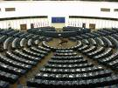
When? Policy Process
DRAFT IA
Rand Europe
1st version of
the IA sent to
IAB
1
IA consultation
2
3
2009 2010 June 2010
4
5
All Stakeholders are invited to respond
YOU ARE ALL STAKEHOLDERS
THE EC NEEDS INPUT, DATA,
ASSESSMENTS , analysis SO THAT THEY CAN
DO A GOOD PROPOSAL
6

Slide 31
When? Policy Process
Co-Decision
EP+Council
2 readings:
18 months
Consultations
TPD priorities
EC
Interservice
consultation
EC proposal
Adopted?
Implementation
1
2
3
End 2010/2011? 2011/12 2012 mid 2013 2014/16
4
5
Your input will
be needed
again
6

Slide 32
Our Strategy & approach
Programme components & action plan
About Burson-Marsteller Brussels
Process Evaluation
Budget
1
Project objectives
2
3
4
5
6

Slide 33
Process Evaluation
Where can we improve our skills?
What can we use again?
What did we learn from the process?
To do our research
Don’t make assumptions
Find out who are the other stakeholders
1
2
3
4
5
6

Slide 34
Our Strategy & approach
Programme components & action plan
Our Team
About Burson-Marsteller Brussels
1
Project objectives
2
3
Why is change so hard to achieve?
4
5
6

Slide 35
Why is change so hard to achieve?
The status quo ‘works’ because it is known. Change is unknown, you have to prove that what you want will ‘work better’
Some people or organisations benefit from the status quo and will oppose change
Change = loss of control = unpredictable = fear
Change requires effort, negotiation, compromise, leadership
No wonder helping people and organisations to change is a specialised profession
1
1
2
2
3
3
4
5
6

Slide 36
Successful advocates communicate:
Why change is needed and why now.
What you want to happen and how things will be different.
Who will benefit and who will lose out.
What it will cost and who will pay for it.
What you want someone to do when they should do it.
How you will help them.
1
1
2
2
3
3
4
5
6

Slide 37
Planning is the KEY:
CHOOSE YOUR “engagement” CAREFULLY
Background - what is the issue, the processes and timeframe?
Define your messages - what do you want to say? What is unique or special about your position?
Identify your targets - who takes the decisions? Who do they listen to? What is important to them?
Select your vehicles - activities, events, information releases, meetings, conferences, media relations, demonstrations, publicity stunts
Check the landscape - who are your allies and opponents? Track their messages and respond.
1
1
2
2
3
3
4
5
6

Slide 38
Our Strategy & approach
Programme components & action plan
Our Team
Elevator Exercise:
Project objectives
1
Budget
2
3
4
5
6

Slide 39
Elevator Exercise:
Which individual is the most important person for you to influence to help your work on?
If you were in a lift with this person and had 60 seconds to talk to them, what would you say?
1
2
3
4
5
6

Slide 40
1
2
3
4
5
6
Thank you for your attention
Notes:
The SFP looks forward to working with you in the coming years….

